Slide 1
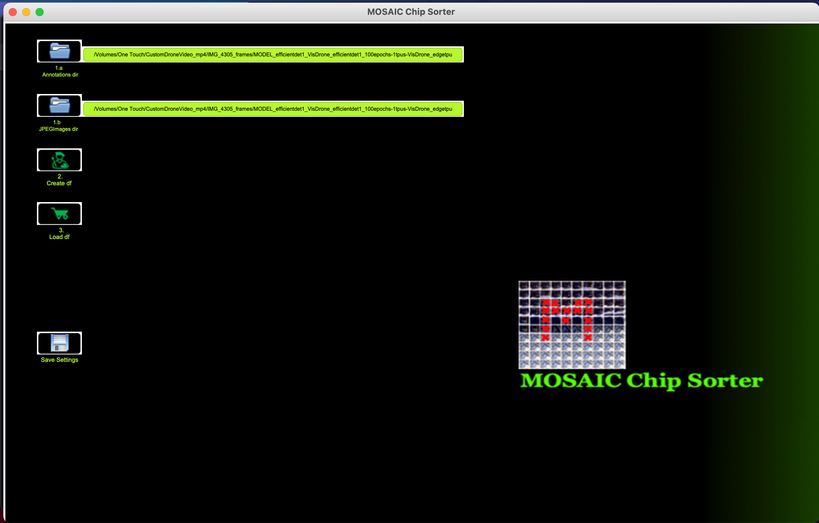
1. Find Annotation & JPEG Images directories.

Slide 2
2. Create Pandas DataFrame of those Annotation & JPEG Images.

Slide 3
3. Load Pandas DataFrame of those Annotation & JPEG Images.

Slide 4
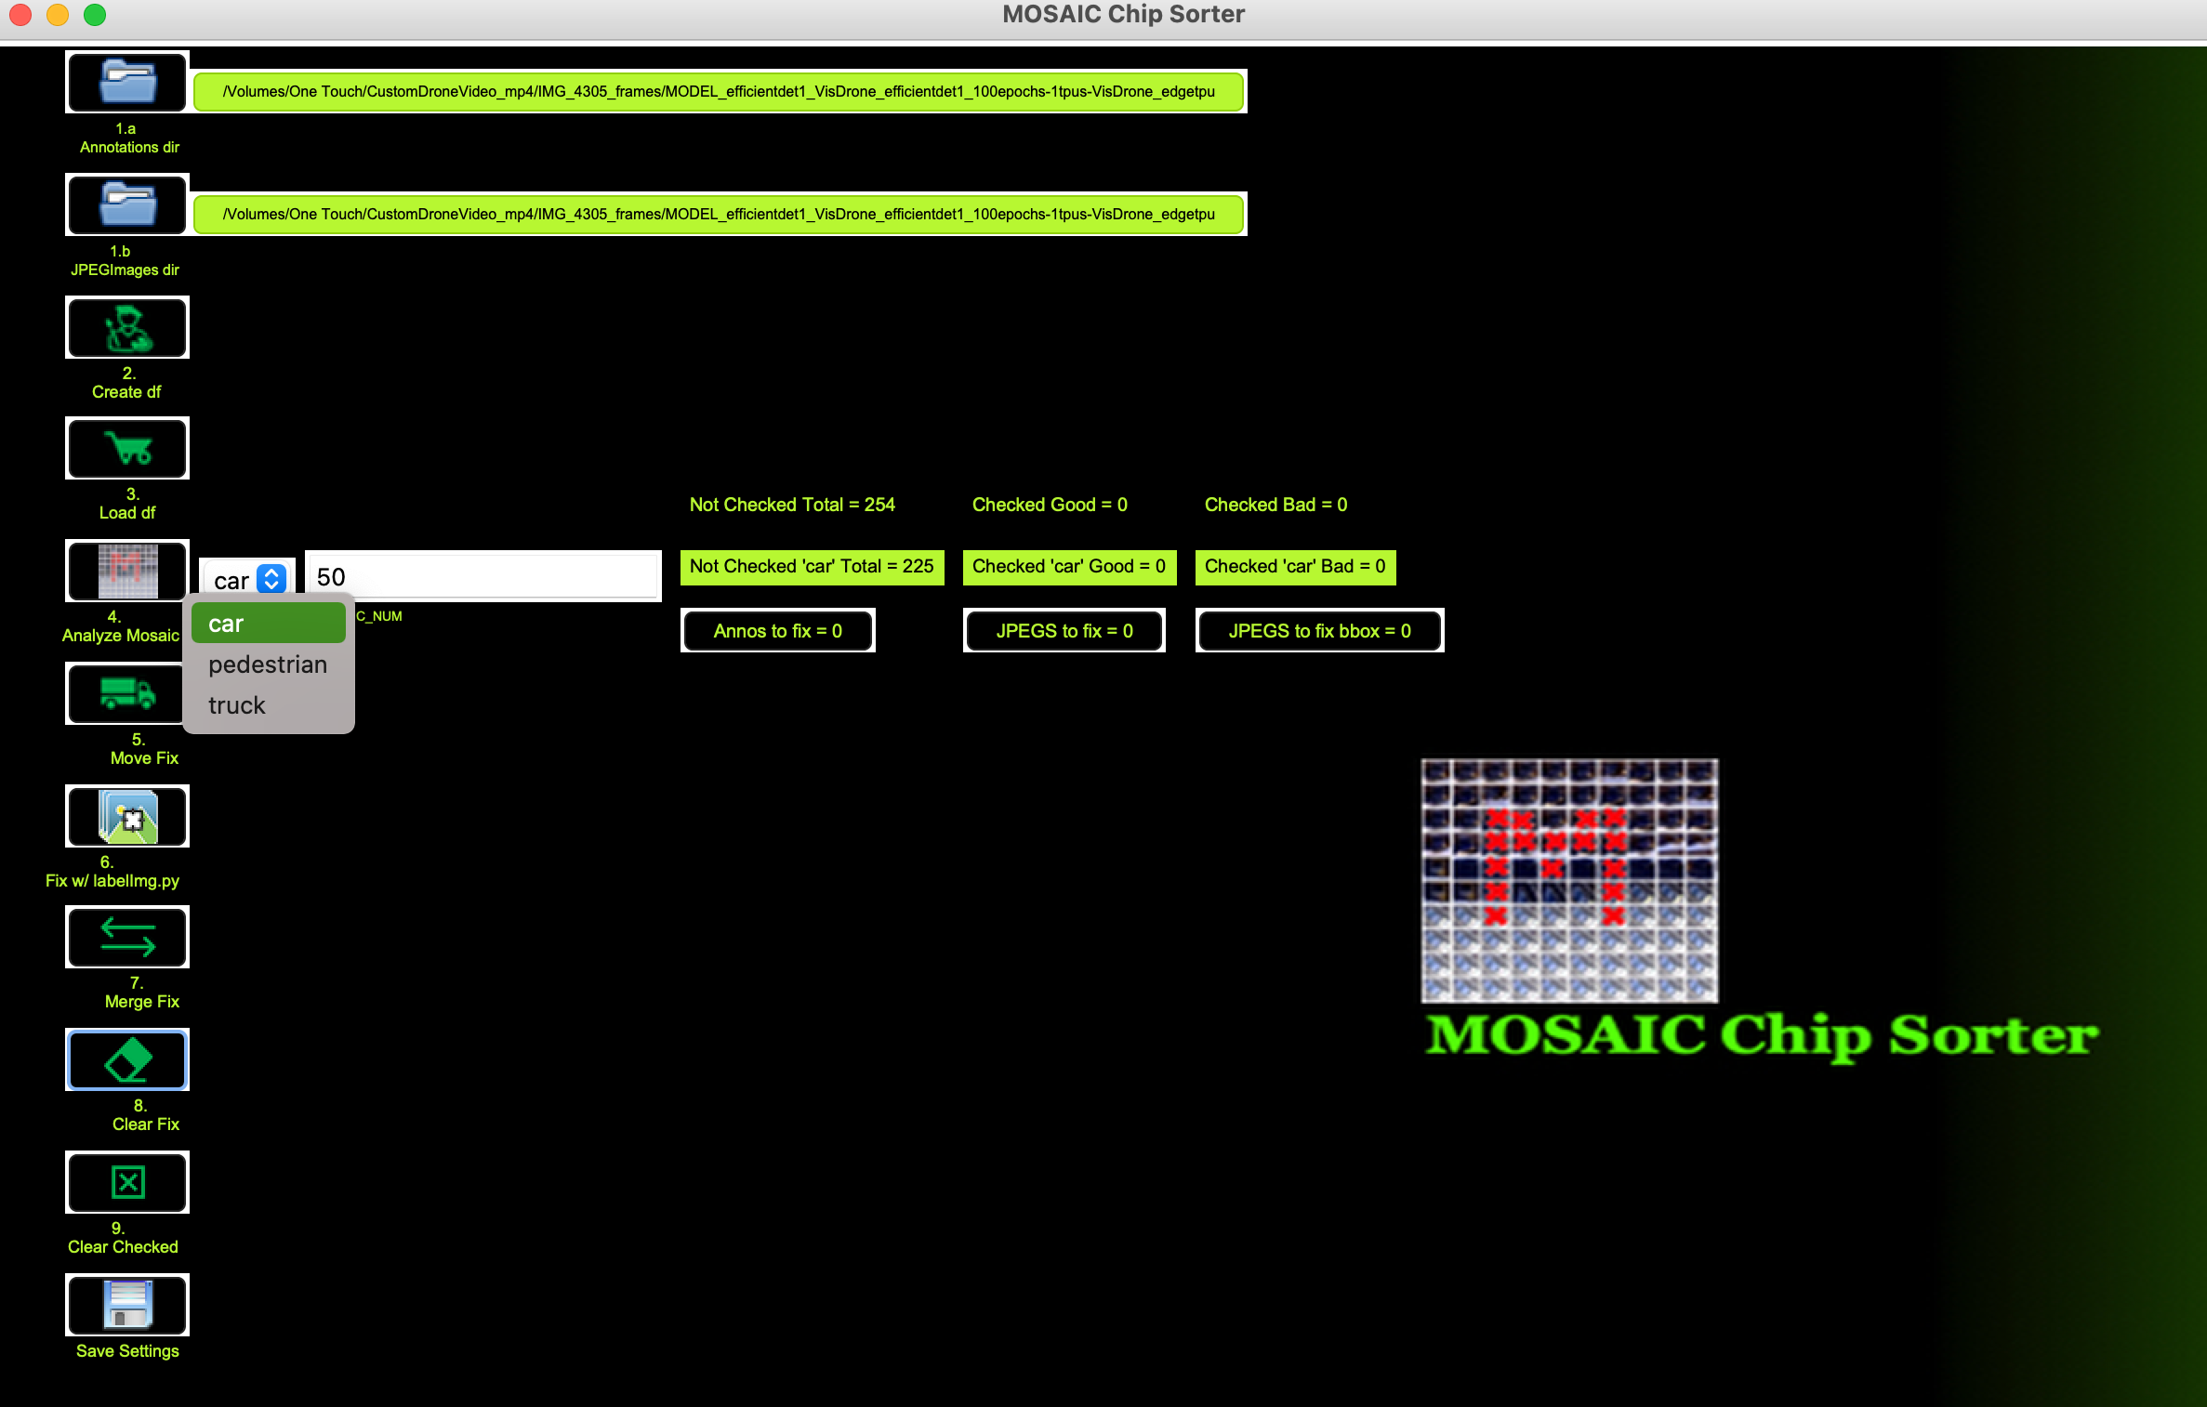
4.a Select target id to create MOSAICs.

Slide 5
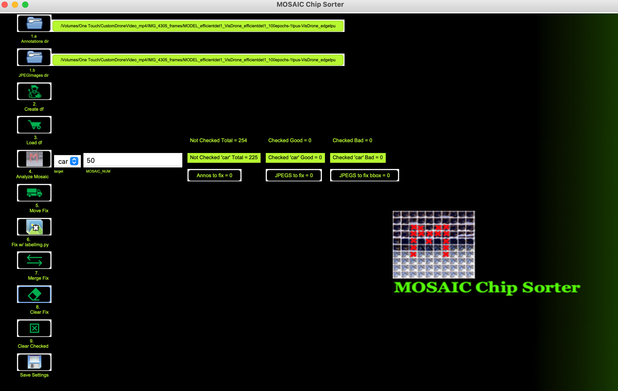
4.b Enter number of chips per MOSAIC.

Slide 6
4.c Analyze MOSAIC.

Slide 7
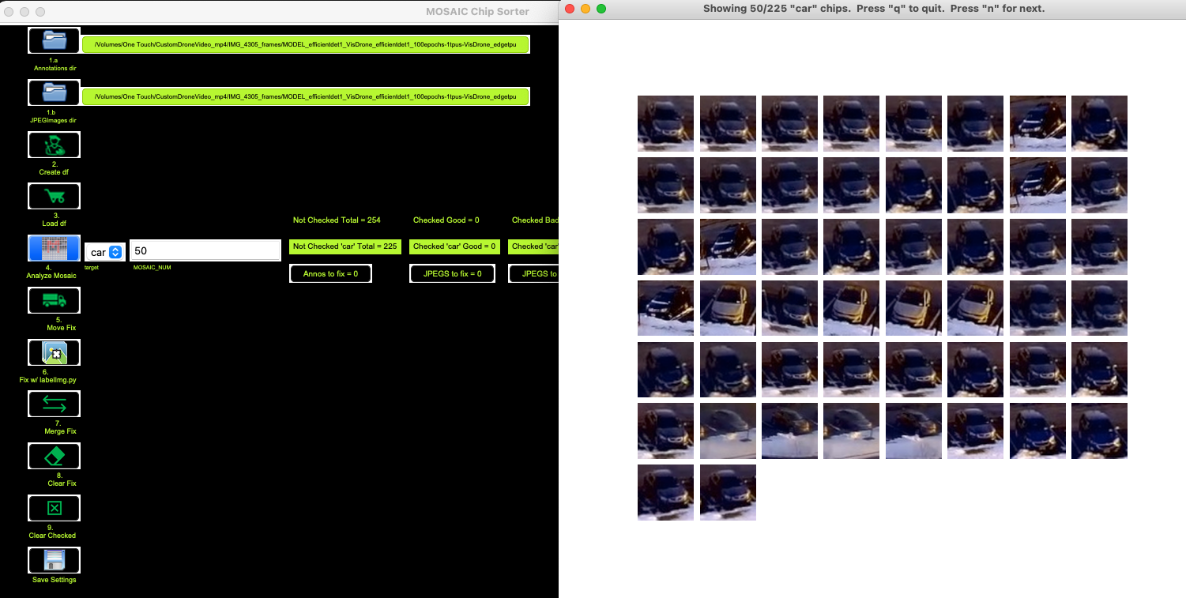
4.d Press “n” if all looks good per MOSAIC PAGE.

Slide 8
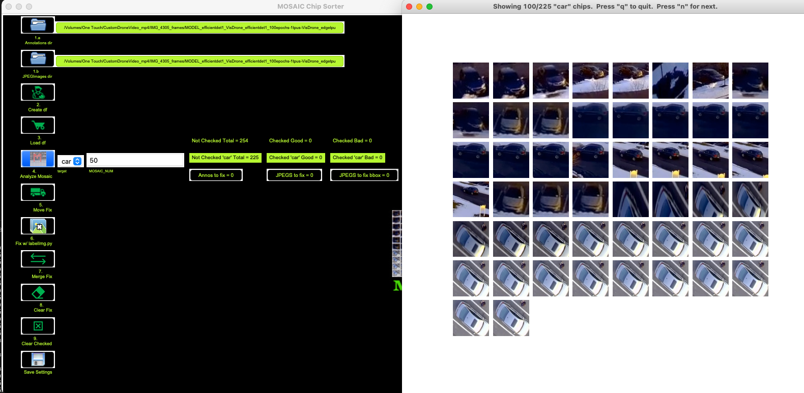
4.e Single click on chip that looks ”bad”. If the wrong chip is selected, double click it.

Slide 9
4.f Press “q” when finished looking.

Slide 10
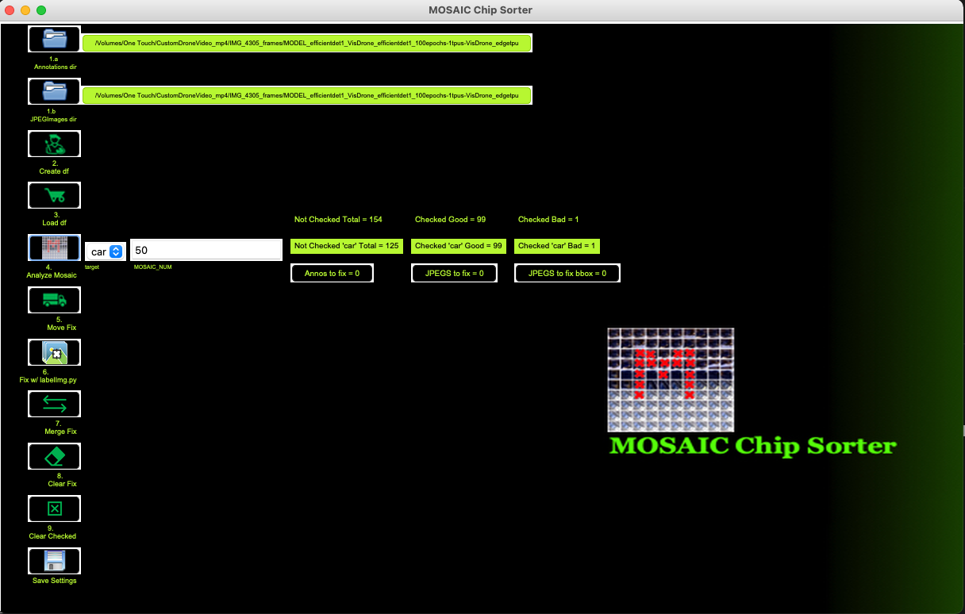
4.g Verify the number you checked and have left.

Slide 11
5.a Move the files to fix to a temporary directory.

Slide 12

5.b Notice the update shows the single “bad” file to fix was moved.

Slide 13
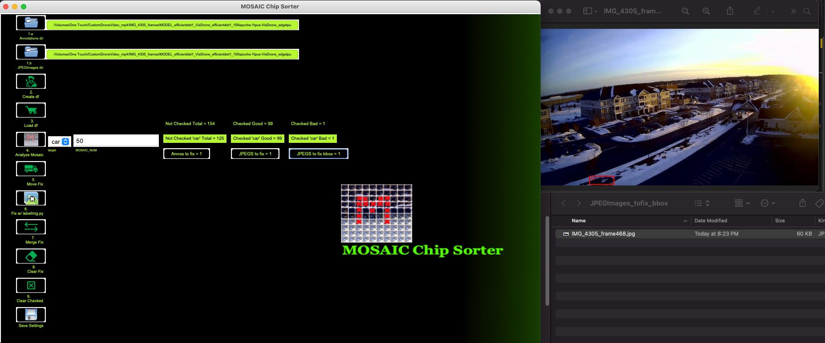
5.c Inspect the JPEGImage to fix bbox file.

Slide 14
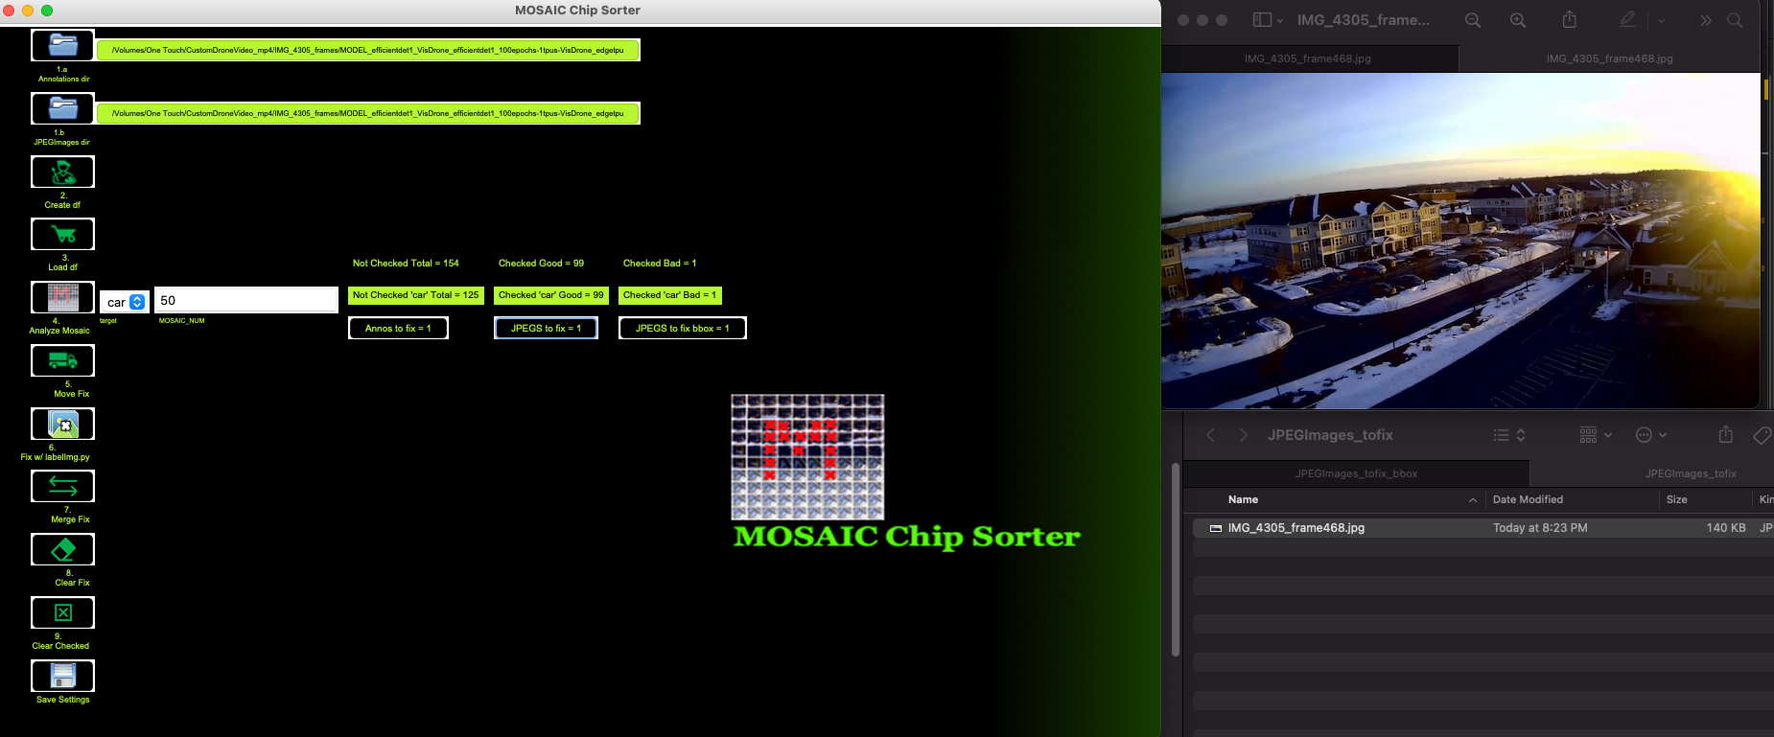
5.d Inspect the JPEGImage.

Slide 15
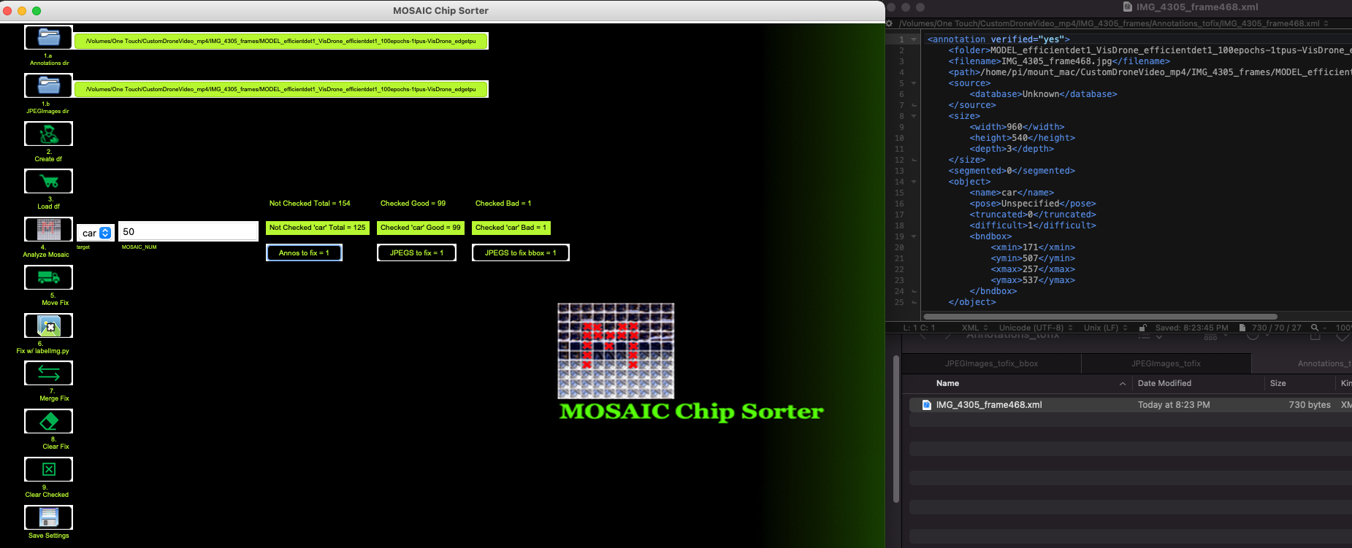
5.e Inspect the Annotation file to fix.

Slide 16
6.a Open the files to fix with labelImg.py.

Slide 17
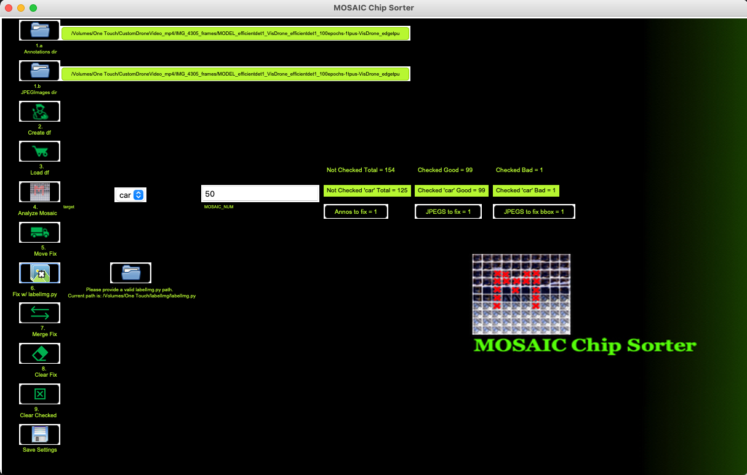
6.b Point to path of your labelImg.py.

Slide 18
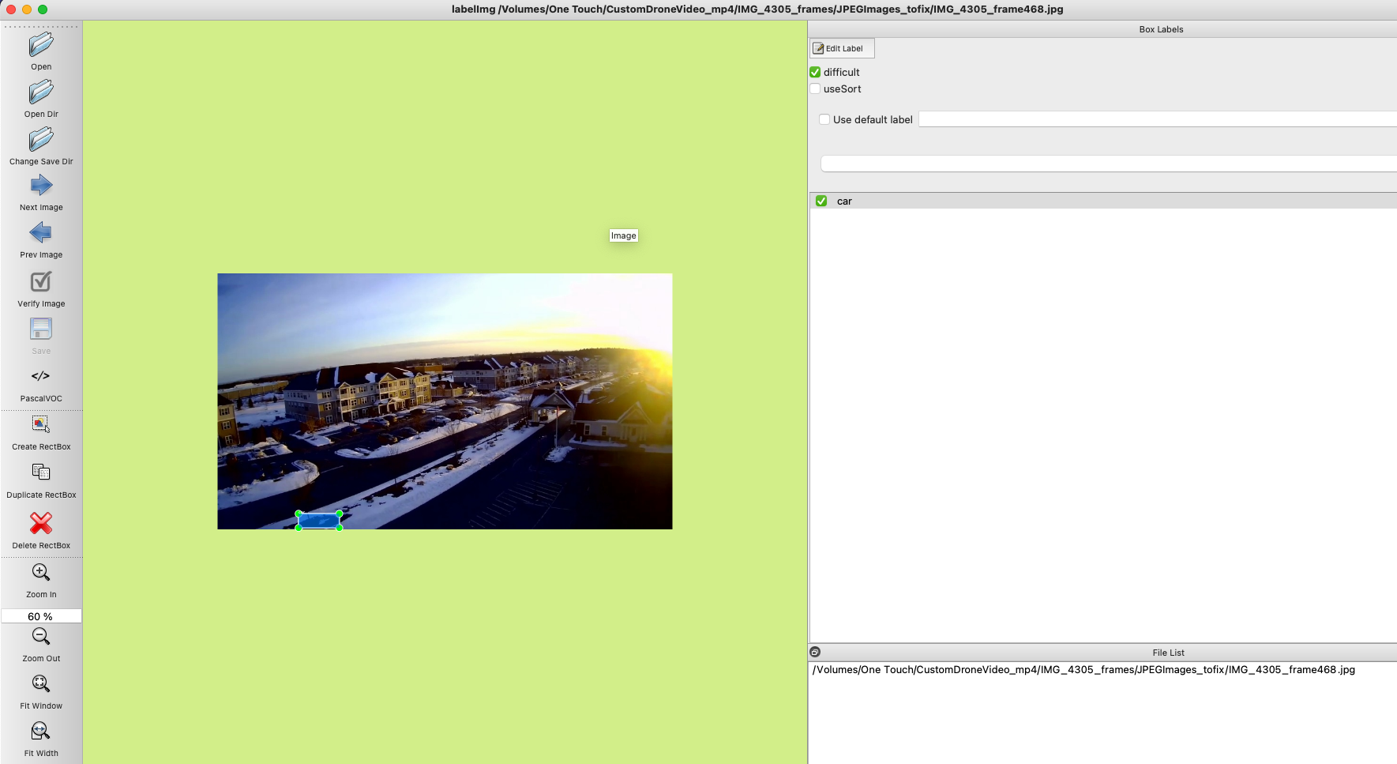
6.c Delete the bad box in this case.

Slide 19
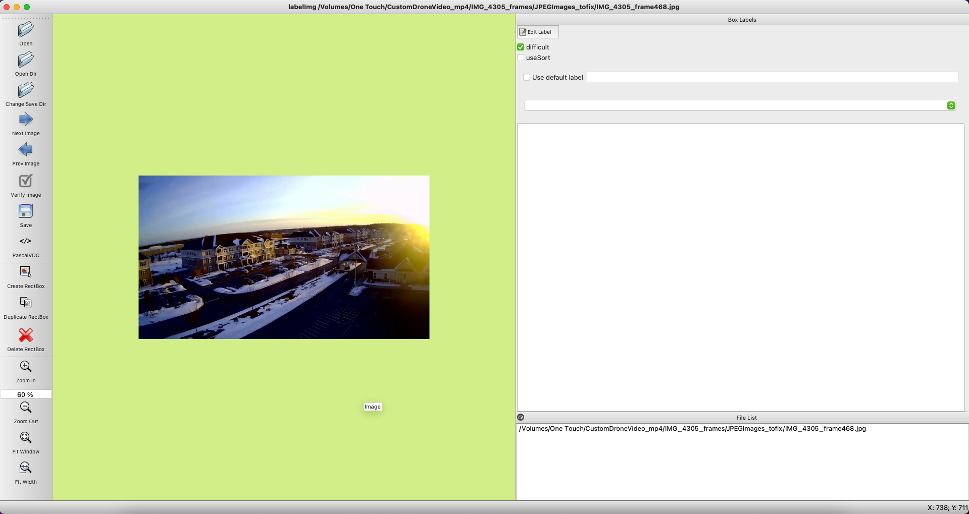
6.d Save.

Slide 20
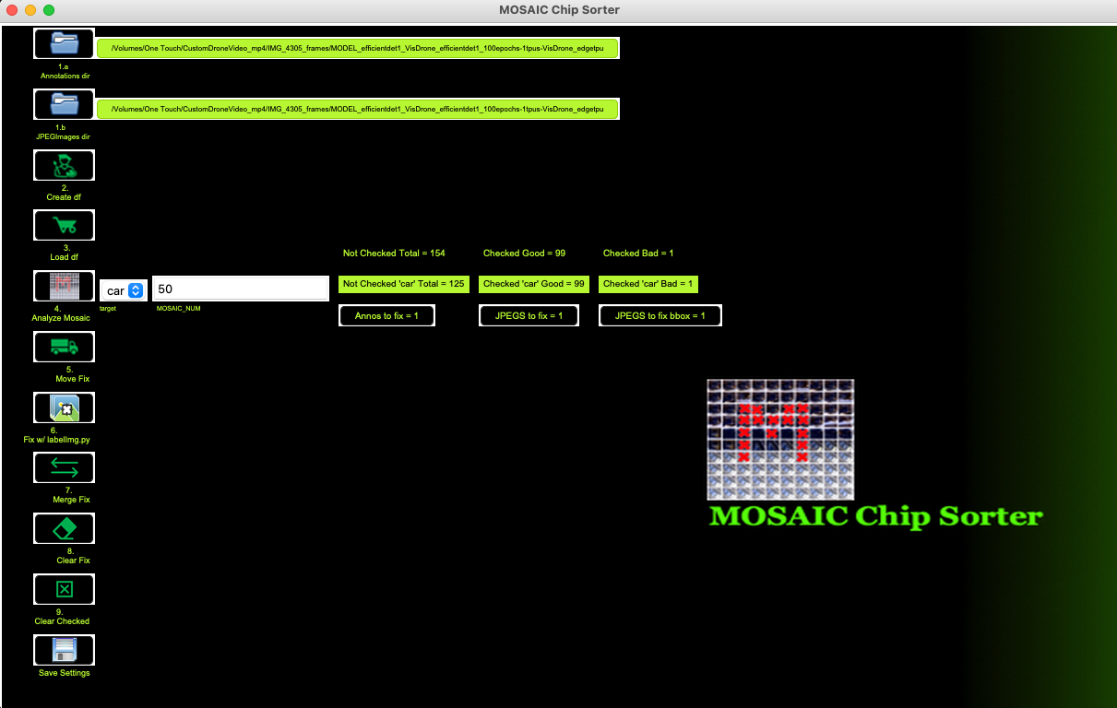
7.a Merge the fixes made to your original directories of Annotations/JPEGs.

Slide 21
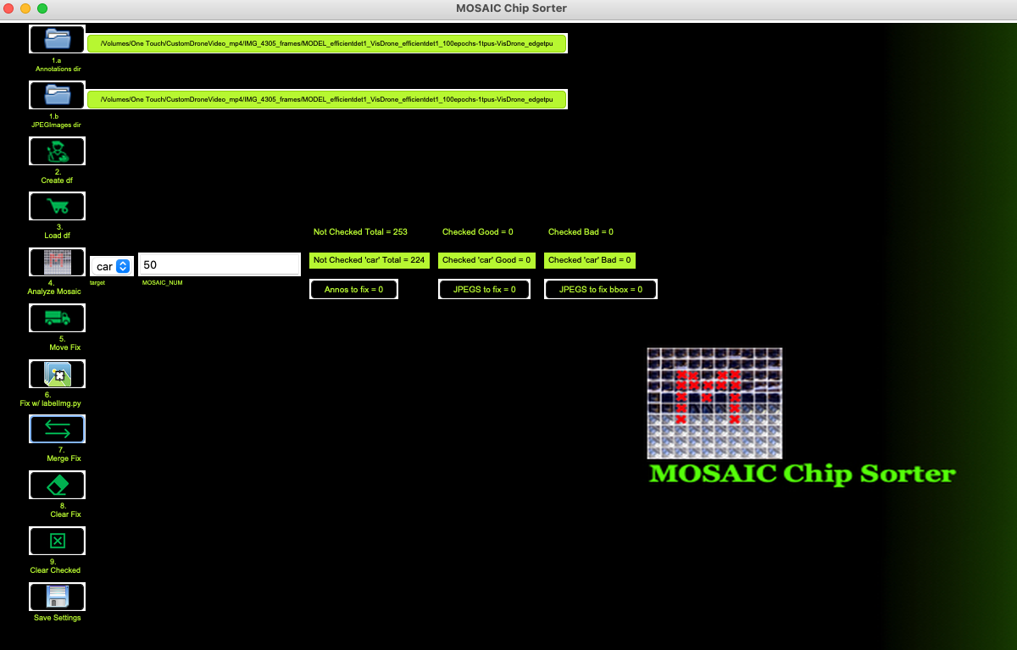
7.b Notice everything is reset now and that chip will no longer show.

Slide 22
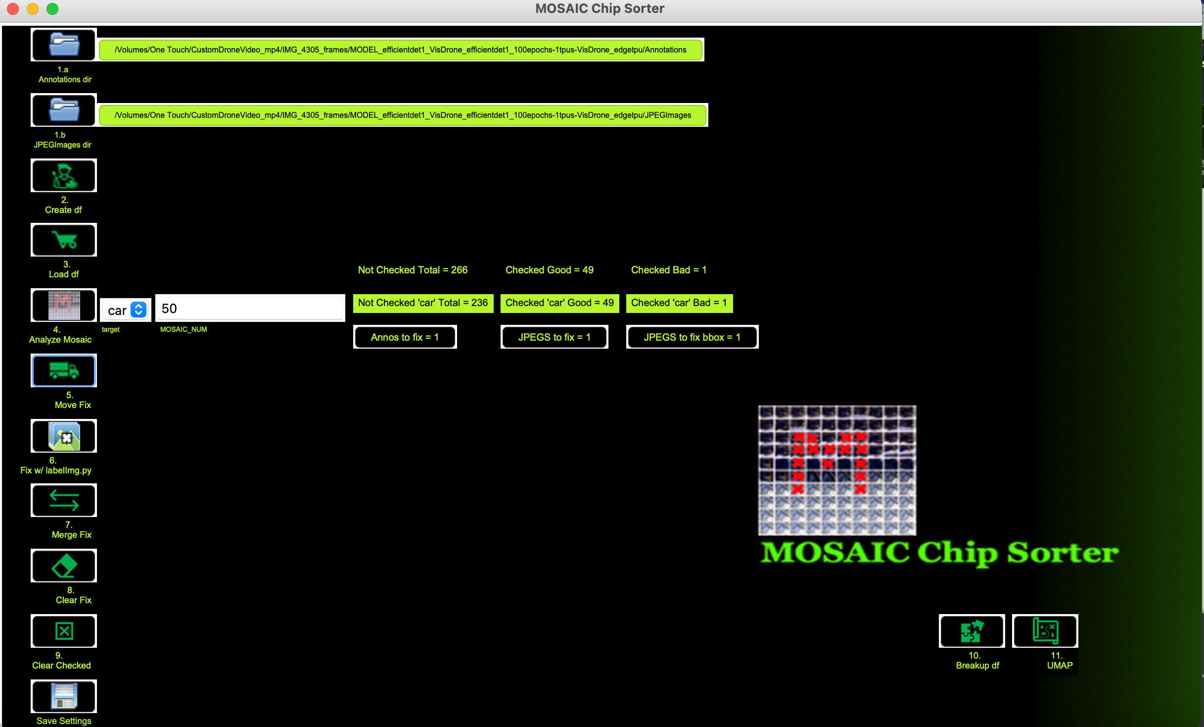
8.a If you had items here in the “to_fix” that you didn’t want to fix (also could manually delete files).

Slide 23
8.b Click “Clear Fix”.

Slide 24

8.c Notice the “to_fix” is clear.

Slide 25
9.a If you wanted to clear what was “checked”.

Slide 26
9.b Click “Clear Checked”.

Slide 27
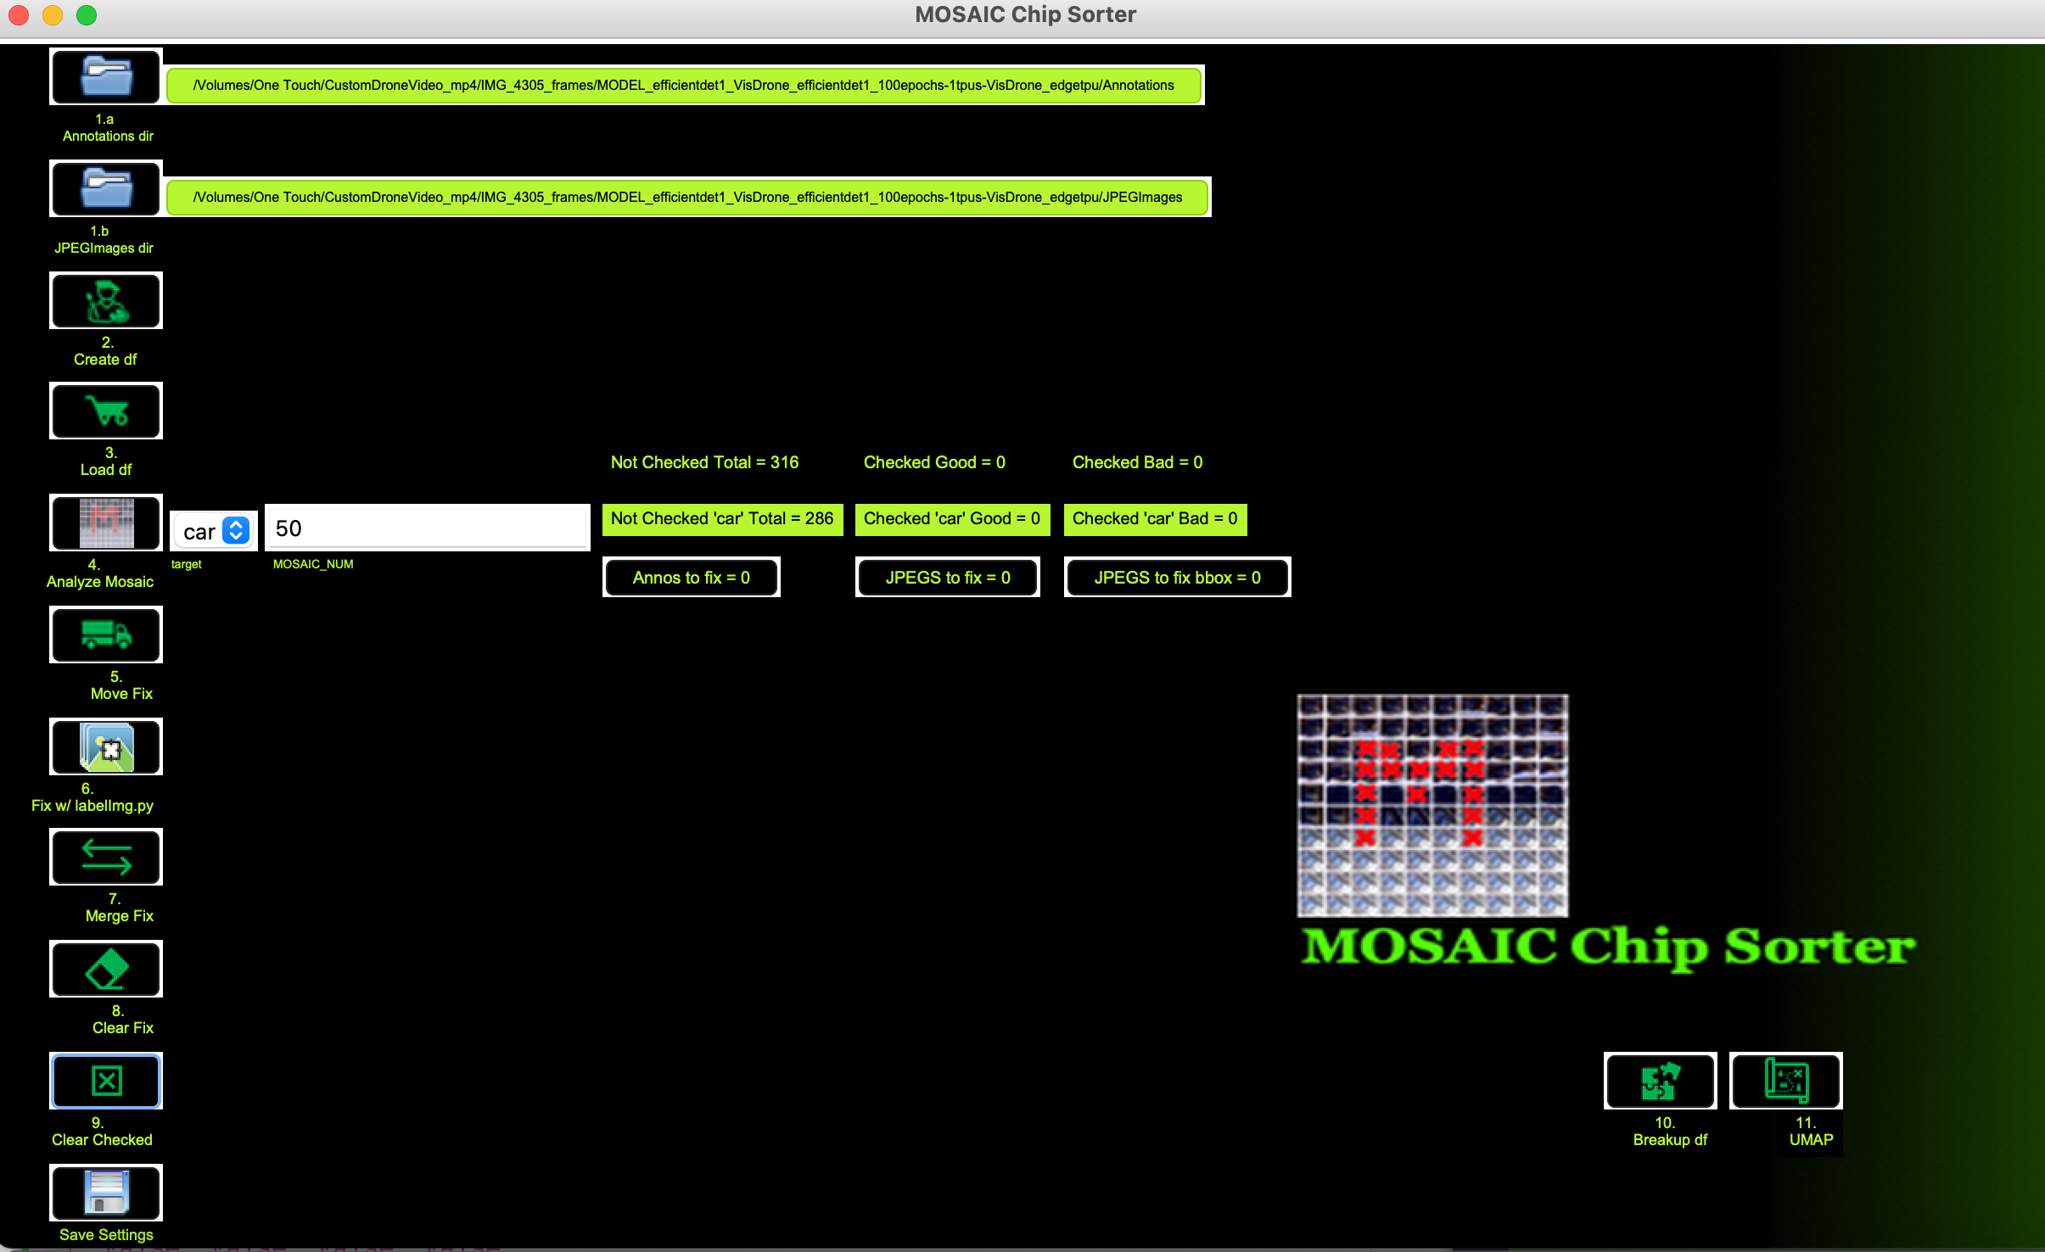
9.c Notice items are cleared from “checked.”

Slide 28
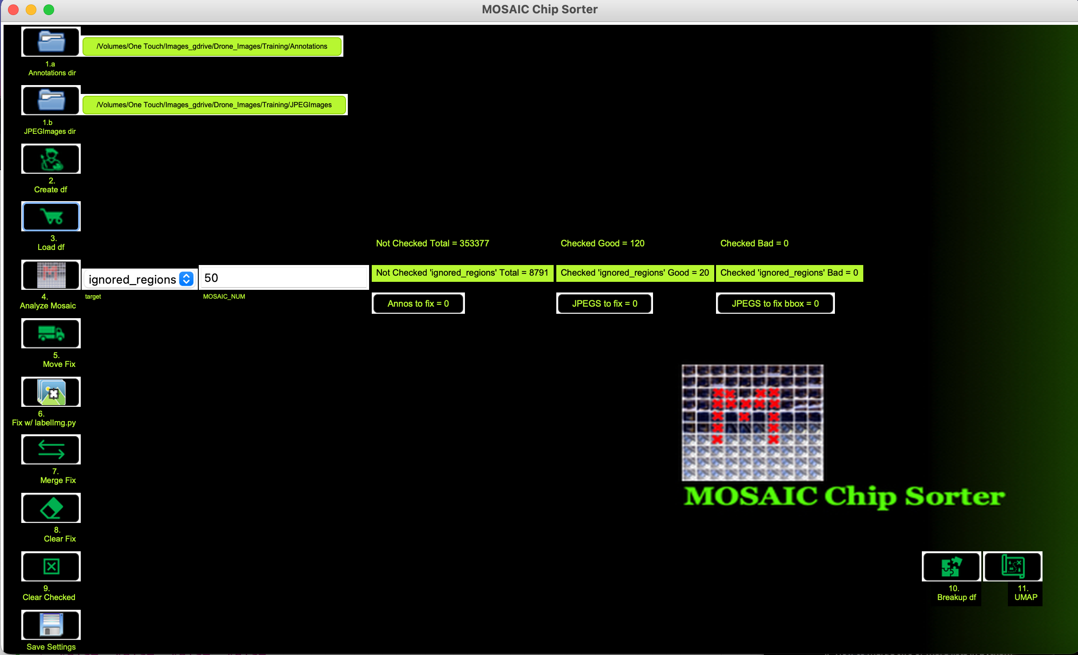
10.a If you want to breakup the Pandas DataFrame to smaller chunks to work with. Click “Breakup df.”

Slide 29
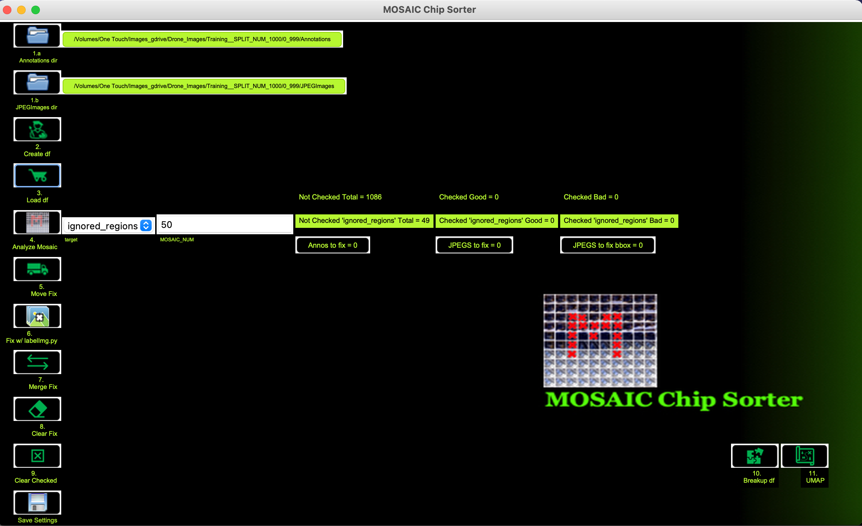
10.b Chunked up into ~1000 annotation chunks.

Slide 30
11.a Use UMAP for clustering chips.

Slide 31
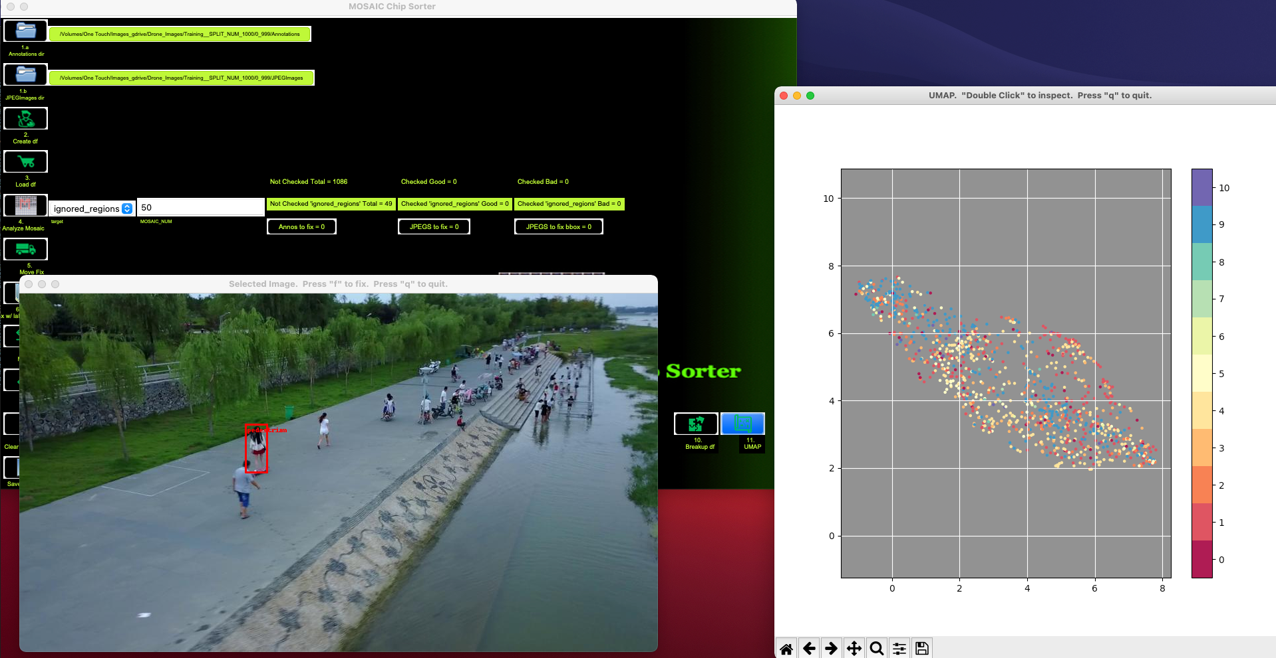
11.b ”Double Click” on UMAP plot of a point of interest to inspect. Press “f” to fix.

